Slide 1
Introduction into OMOP Oncology Module

Slide 2
Components of Extension
Cancer Diagnosis Model
Cancer Treatment Model
Cancer Episode Model
1
2
3
Notes:
The extension has been tested in EHR and Cancer Registry data against a number of typical use cases.

Slide 3
Cancer Diagnosis Model
1
Base Diagnosis
Topography + Histology
Diagnostic Modifiers
Staging/Grading
Topography
Histological pattern
Dimension
Extension/Invasion
Metastasis
Margin
Biomarker
Base Diagnosis
Carcinoma of Bladder
Topography
Posterior wall
Metastasis
Left adrenal gland
Stage
T2bN2M0
Genomic Variant
KRAS c.35G>A

Slide 4
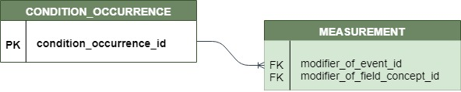
Base Diagnosis in CDM & Vocabulary
1
CDM: CONDITION_OCCURRENCE, Domain “Condition”
Vocabulary: SNOMED + OMOP (ICD-O-3 combined)
Standard Base Diagnosis concepts = combination of
Histology + Topography
(histological type of tumor) (organ or anatomical location)
SNOMED
SNOMED
SNOMED
Primary malignant neoplasm of posterior wall of urinary bladder
Structure of posterior wall of urinary bladder
Neoplasm, malignant
SNOMED
OMOP
SNOMED
Carcinoma
Carcinoma, NOS, of posterior wall of bladder
Structure of posterior wall of urinary bladder
ICD-O
OMOP
ICD-O
Carcinoma, NOS
Carcinoma, NOS, of posterior wall of bladder
Posterior wall of bladder

Slide 5
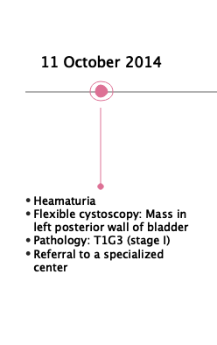
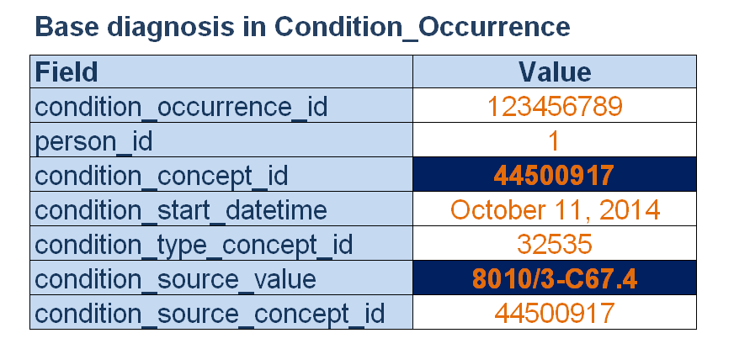
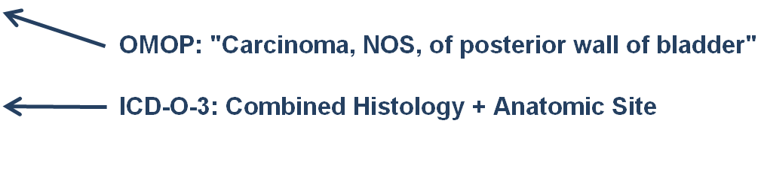
Base Diagnosis in OMOP CDM
1

Slide 6
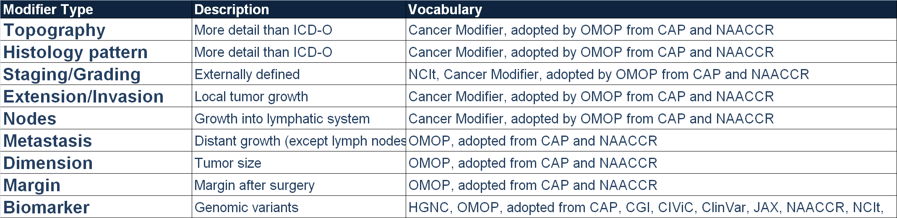
Diagnostic Modifiers in CDM & Vocabulary
1
CDM: MEASUREMENT, Domain “Measurement”
Vocabulary:
Standard Modifier concepts - from designated “Cancer Modifier” vocabulary
Standard Value concepts are usual attribute values (e.g. ‘Present’, ‘Absent’)

Slide 7
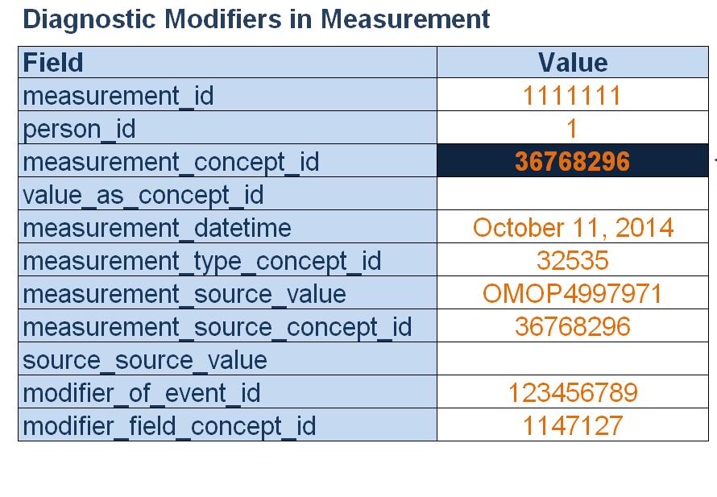

Diagnostic Modifiers in OMOP CDM
1

Slide 8
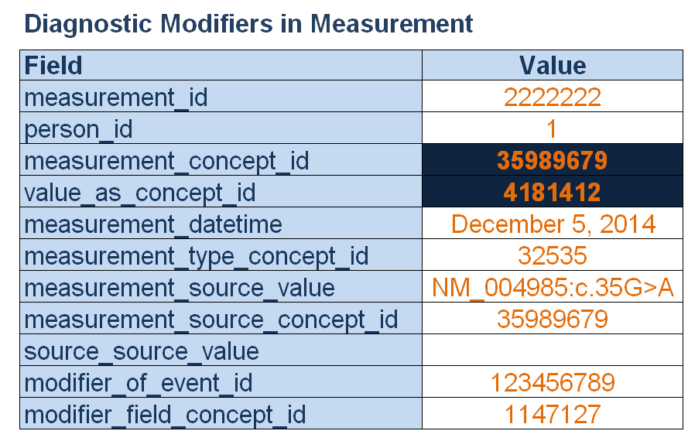
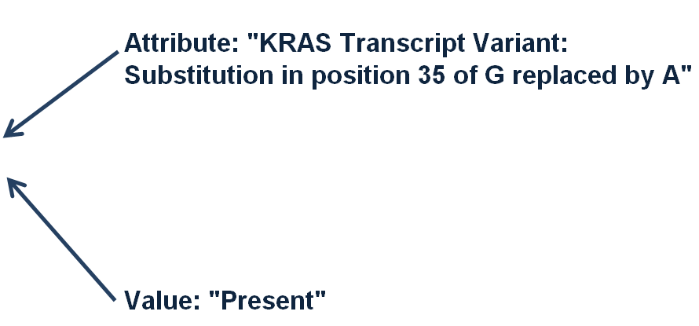
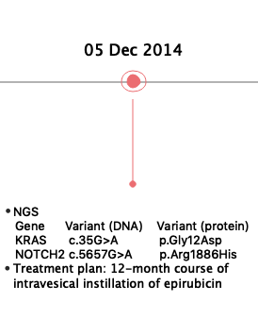
Diagnostic Modifiers in OMOP CDM
1

Slide 9
Connection Base Diagnosis-Modifier
1
Base Diagnosis
Modifier
Modifier
Modifier
Modifier

Slide 10
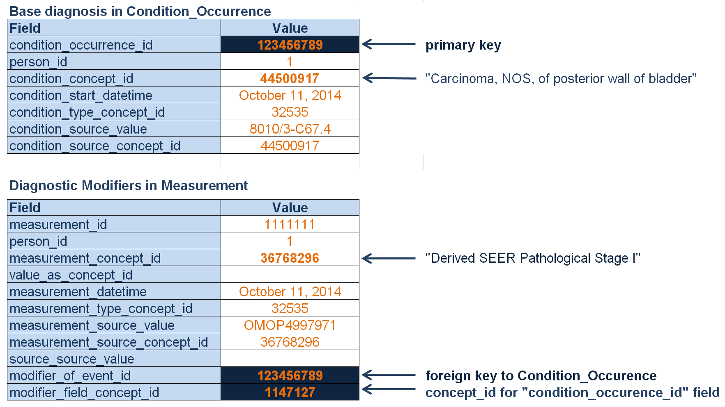
Connection Base Diagnosis-Modifier
1

Slide 11
Learned: Cancer Diagnosis Model
1
Cancer Diagnosis = Base Diagnosis + Diagnostic Modifiers
2. Base Diagnosis in CONDITION:
Histology + Anatomic Site
3. Diagnostic Modifiers in MEASUREMENT:
Topography
Staging/Grading
Histological pattern
Biomarker
Margin
Metastasis
Dimension
Extension/Invasion
4. One-to-many connection between them

Slide 12
Components of Extension
Cancer diagnosis model
Cancer treatment model
Cancer episode model
1
2
3
Notes:
The extension has been tested in EHR and Cancer Registry data against a number of typical use cases.

Slide 13
Treatment Model
2
Composite Treatment
Individual Treatment
Chemotherapy Regimen
Gemcitabine-Cisplatin
Drug Exposure
Cisplatin
Drugs
Chemotherapy Cycle
Cycle 1
Drug Exposure
Gemcitabine
Radiation therapy
External beam radiotherapy
Individual radiotherapy
Proton treatment delivery; intermediate
Procedures
Surgical therapy
Transurethral resection of bladder neoplasm

Slide 14
Treatment Model
2
Composite Treatment
Individual Treatment
Chemotherapy Regimen
Gemcitabine-Cisplatin
Drug Exposure
Cisplatin
Drugs
Chemotherapy Cycle
Cycle 1
Drug Exposure
Gemcitabine
Episodes
Radiation therapy
External beam radiotherapy
Individual radiotherapy
Proton treatment delivery; intermediate
Procedures
Surgical therapy
Transurethral resection of bladder neoplasm

Slide 15
Individual Procedure Treatments Individual Drug Treatments
2
Standard OMOP
In DRUG_EXPOSURE, Domain “Drug”
In PROCEDURE_OCCURRENCE, Domain “Procedure”

Slide 16
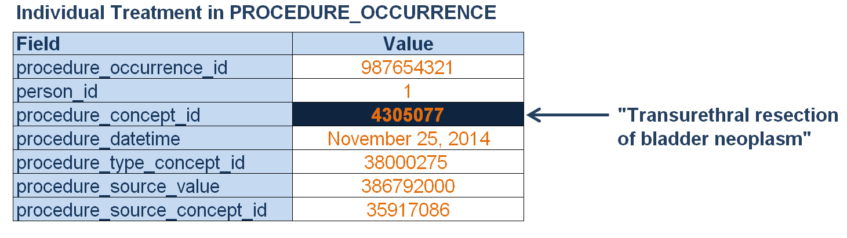
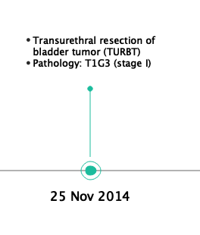
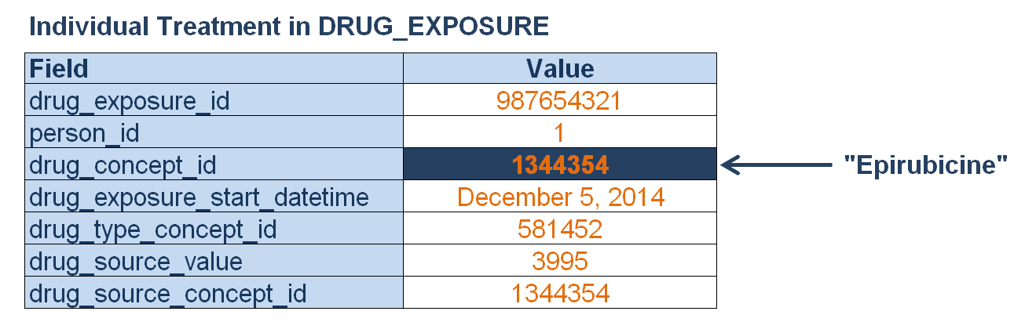
Individual Treatments in OMOP CDM
2

Slide 17
Learned: Cancer Treatment Model
2
Treatment :
Composite (High Level) or Individual (Low Level)
High Level in EPISODE
Low Level in Standard OMOP:
DRUG_EXPOSURE
PROCEDURE_OCCURRENCE

Slide 18
Components of Extension
Cancer diagnosis model
Cancer treatment model
Cancer Episode Model
1
2
3
Notes:
The extension has been tested in EHR and Cancer Registry data against a number of typical use cases.

Slide 19
Episode Model
3
What are Episodes? Continuous periods of disease or treatment that have distinct clinical meaning and are composed of multiple events, e.g.
• Progressive Disease Episode
• Treatment Regimen
Why do we need them? For analytical use cases, e.g.
• Overall and Progression-Free Survival (OS, PFS)
• Time to progression
• Response to treatment
How do we get them? Directly from source data (e.g. registries) or algorithmically derived

Slide 20
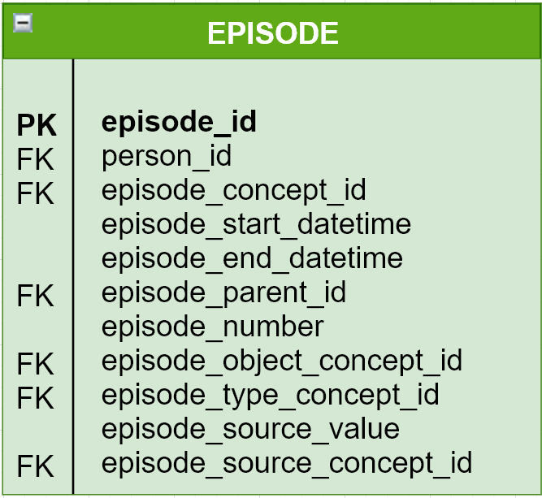
New table: EPISODE
3
Abstracted Episode
Timing
Nesting of Episodes
Episode chaining
Value of EAV

Slide 21
Attribute-Value = Sentence
3
Remission
10-Dec-2015
8-Jan-2016
Bladder Cancer
Sentence: “Remission of Bladder Cancer”

Slide 22
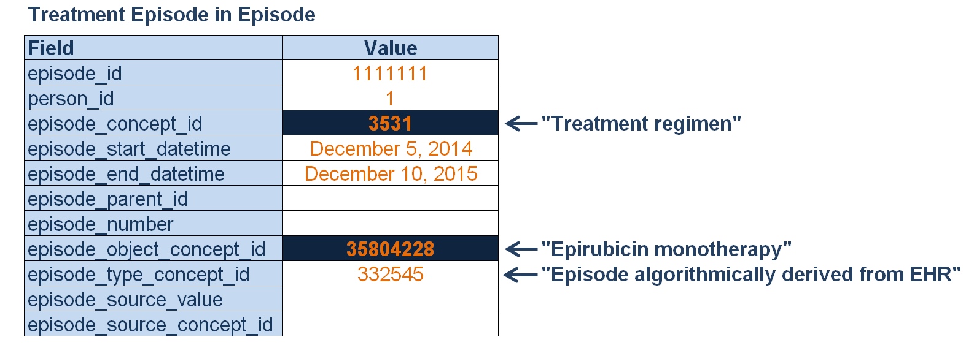
Treatment Episode in OMOP CDM
3
Sentence: “Treatment regimen of Epirubicin monotherapy”

Slide 23
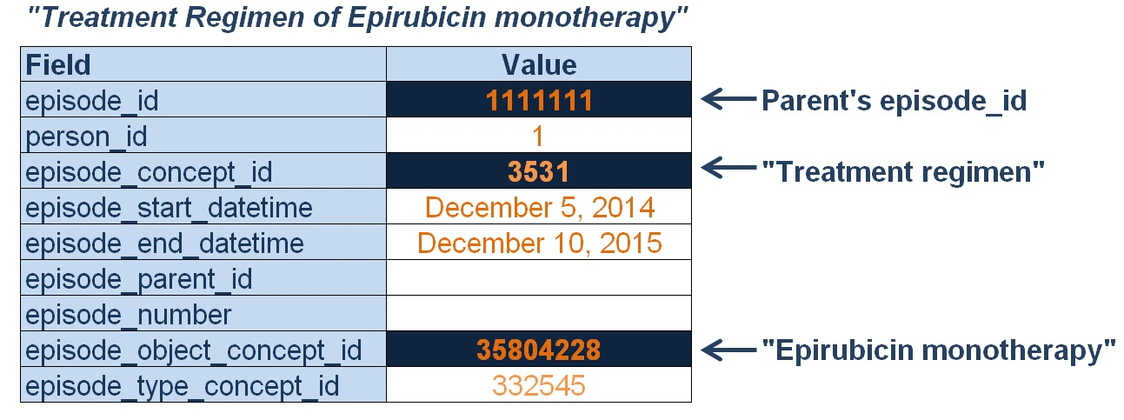
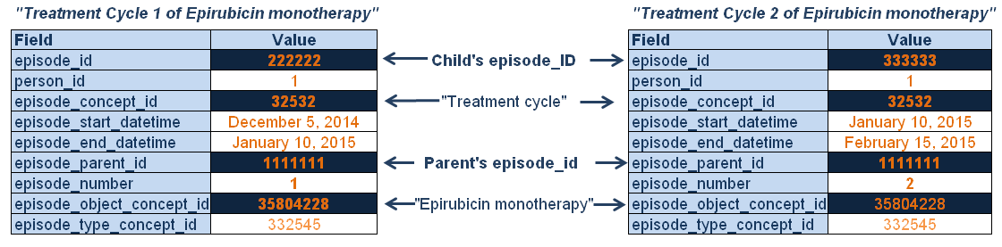
Episodes Nesting
3

Slide 24
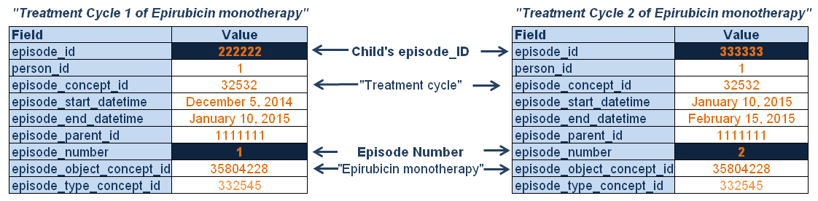
Episodes Chaining
3

Slide 25
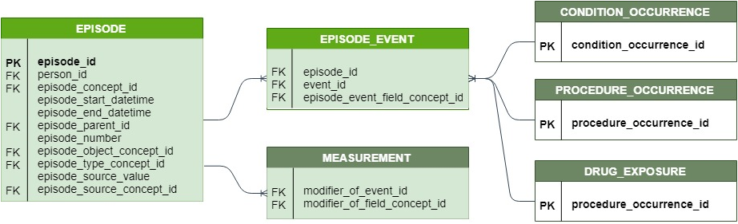
Connection Episode–Events
3
Episode
Events
Many-to-many connector
Diagnostic Modifiers

Slide 26
Disease Episodes
3
Parent Episode:
Overarching disease episode
Covers the entire cancer duration
Children Episodes:
Disease dynamic:
no disease, stable, improving, worsening
Disease extent:
confined, invasive, metastatic

Slide 27
Disease Episode Concepts and Rules
3
Concepts
Start and End Rules
Domain “Episode”
Overarching: “Episode of disease”
Extent
“Confined Disease”
“Invasive Disease”
“Metastatic Disease”
Dynamic
“Remission”
“Complete Remission”
“Stable Disease”
“Progression”
“Disease Recurrence”
Starts with diagnosis, spans everything
Starts with evidence (Diagnostic Modifier)
Ends with start of next Extent Episode
Starts with evidence (Diagnostic Modifier, Surgery)
Ends with next Treatment Episode or new evidence

Slide 28
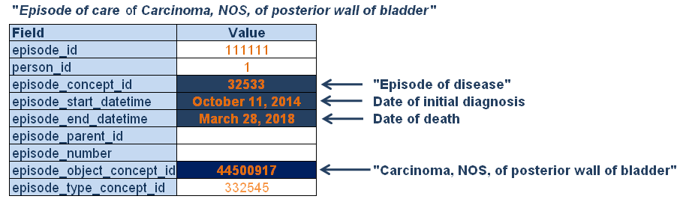
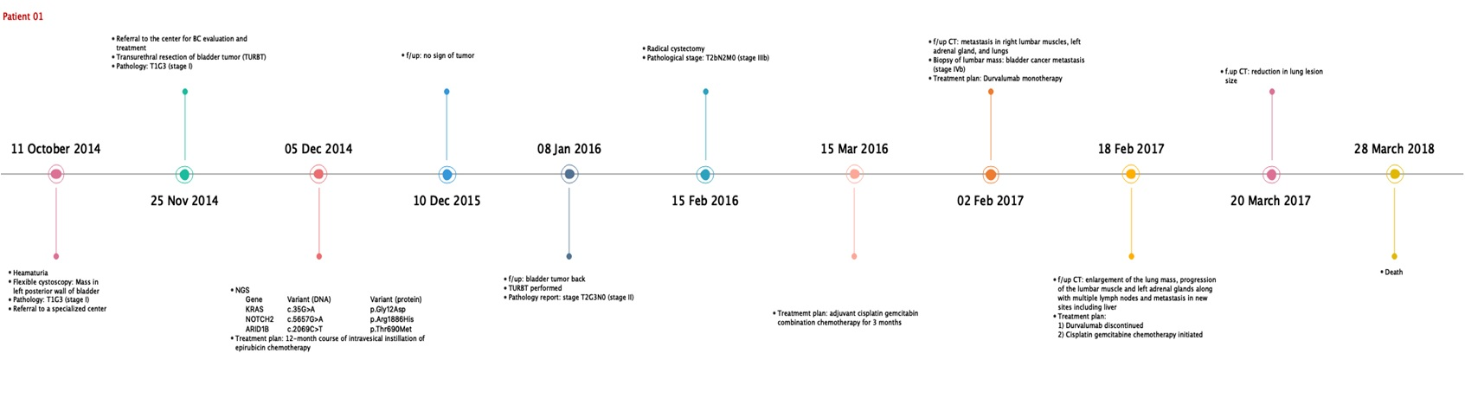
Overarching Disease Episode
3

Slide 29
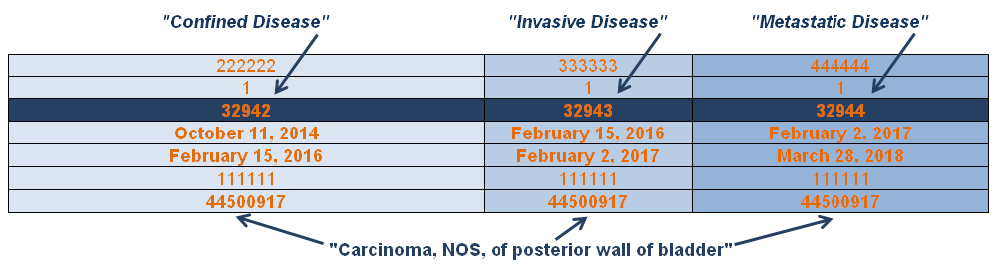
Extent of Disease Episodes
3

Slide 30
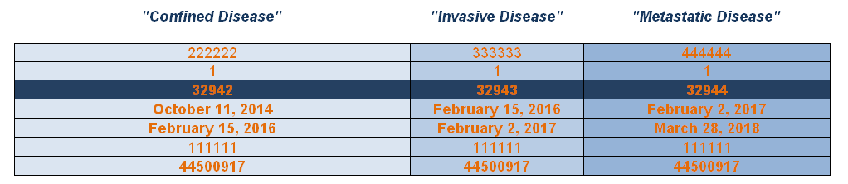
Research Question
3
Time to Metastatic Disease

Slide 31
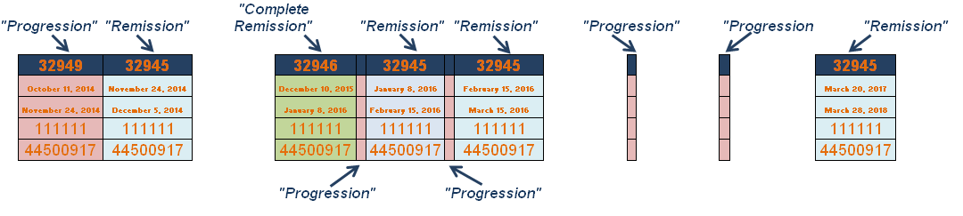
Dynamic of Disease Episodes
3

Slide 32
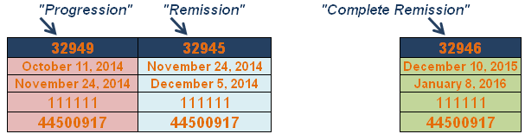
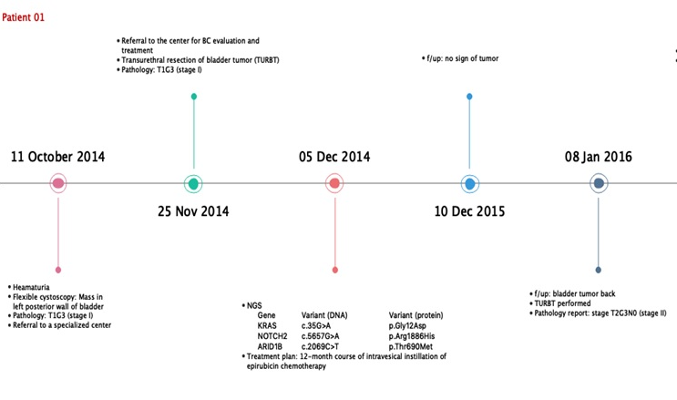
Dynamic of Disease Episodes
3
Progression
Oct 11, 2014 – Nov 24, 2014
Starts with evidence, Initial Diagnosis
Ends with next treatment, Surgery
Remission
Nov 24, 2014 – Dec 5, 2014
Starts with next treatment, Initial Surgery
Ends with next treatment, Epirubicin
No information
Dec 5, 2014 – Dec 10, 2015
Starts with next treatment
Ends with new evidence
Complete Remission
Dec 10, 2015 – Jan 8, 2016
Starts with new evidence, “f/u: no sign of tumor”
Ends with new evidence, “f/u: bladder tumor back”

Slide 33
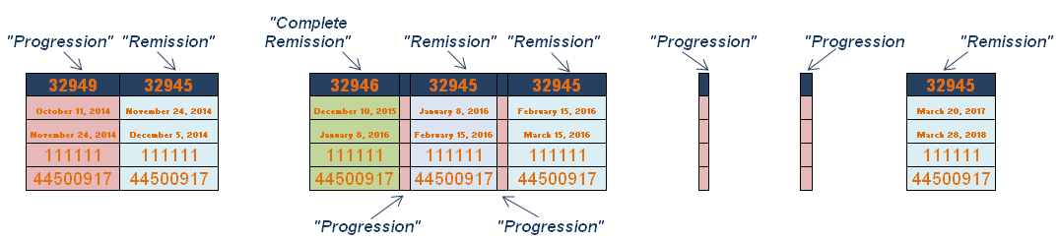
Research Question
3
Time to Recurrence

Slide 34
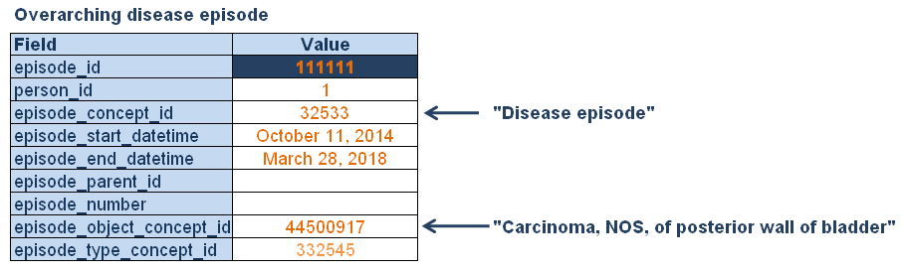
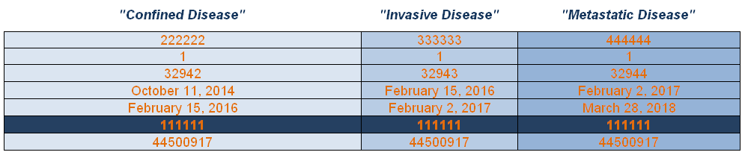
Nested Disease Episodes
3

Slide 35
Learned: Cancer Episode Model
3
Episodes are abstract high-level periods of disease or treatment that have distinct clinical meaning
We need them for deriving analytical use cases
There are Disease and Treatment Episodes
There are three Disease Episodes types:
Overarching
Extent
Dynamic
Episodes are composed of two concepts:
Episode Concept (Disease Progression, Treatment Regimen)
Episode Object (concepts from Condition, Procedure and Drug domains)
Episodes can be nested

